Slide 1
Delay-Sensitive Behavior and Patient Access in First Come First Serve

Slide 2
Existing appointment scheduling approaches lead to long wait and idleness
Long waits can change patient behavior, leading to no-show and balking.
These behaviors lower overall served rate and waste utilization capacity.
Question: How does patient sensitivity to appointment delay affect patient access and efficiency?
We focus on three metrics:
  Average utilization: on average, the fraction of appointment capacity that becomes completed visits.
  Served rate: the fraction of arriving patients that receive care.
  Waiting time: the average delay of all appointments offered

Slide 3
Patient delay-sensitive behaviors
Balking
The patient is offered an appointment, but decides to not take it because the wait is too long.
No-show
The patient is offered an appointment, but decides to not show-up because the wait is too long.

Slide 4
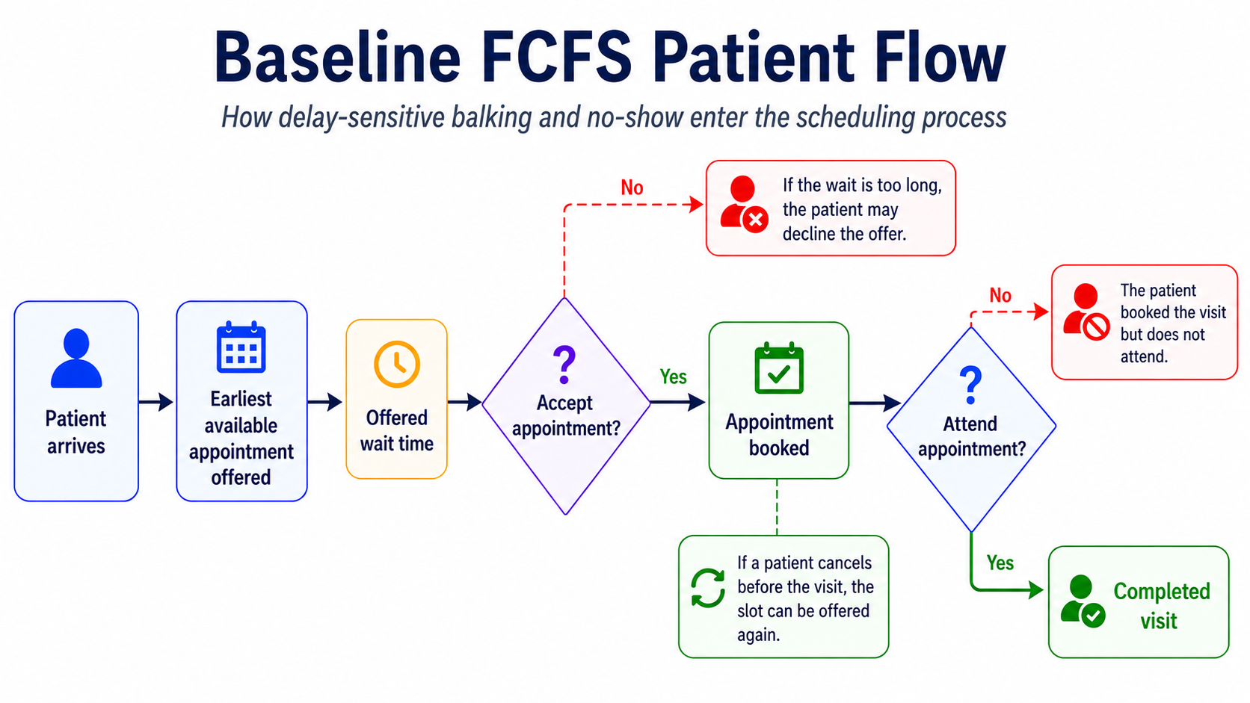
30 day burn-in 365-day measurement period 10-day cooldown

Slide 5
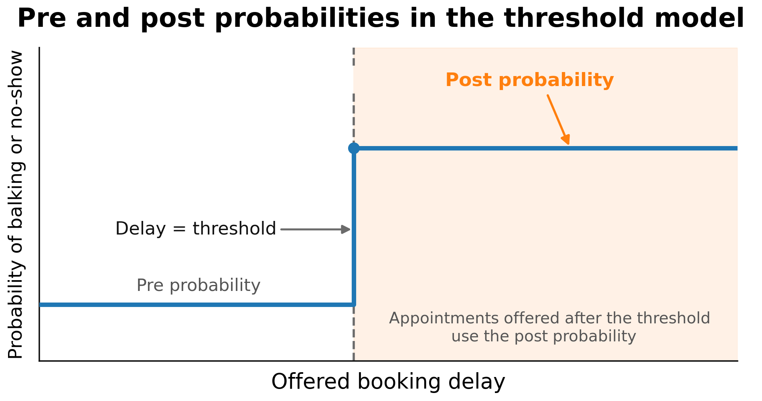
Threshold mechanisms: probabilities and delay
For both no-show and balking behavior of both classes

Slide 6
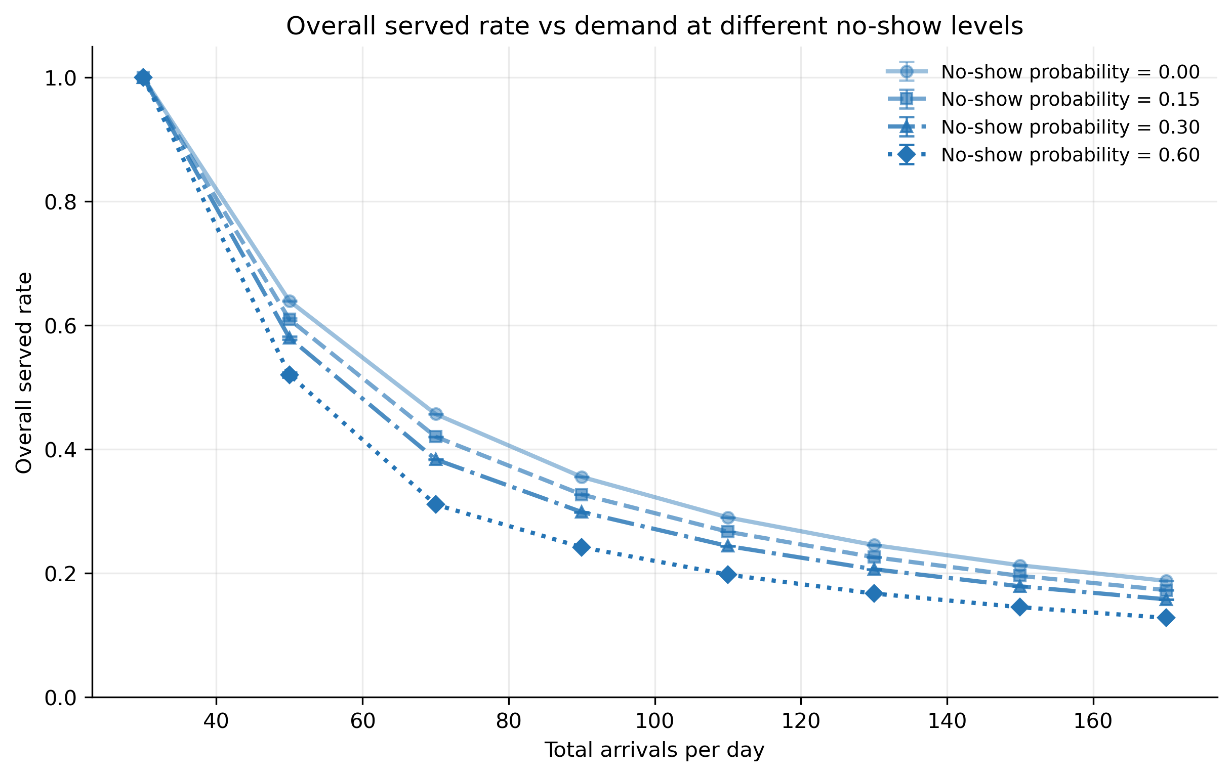
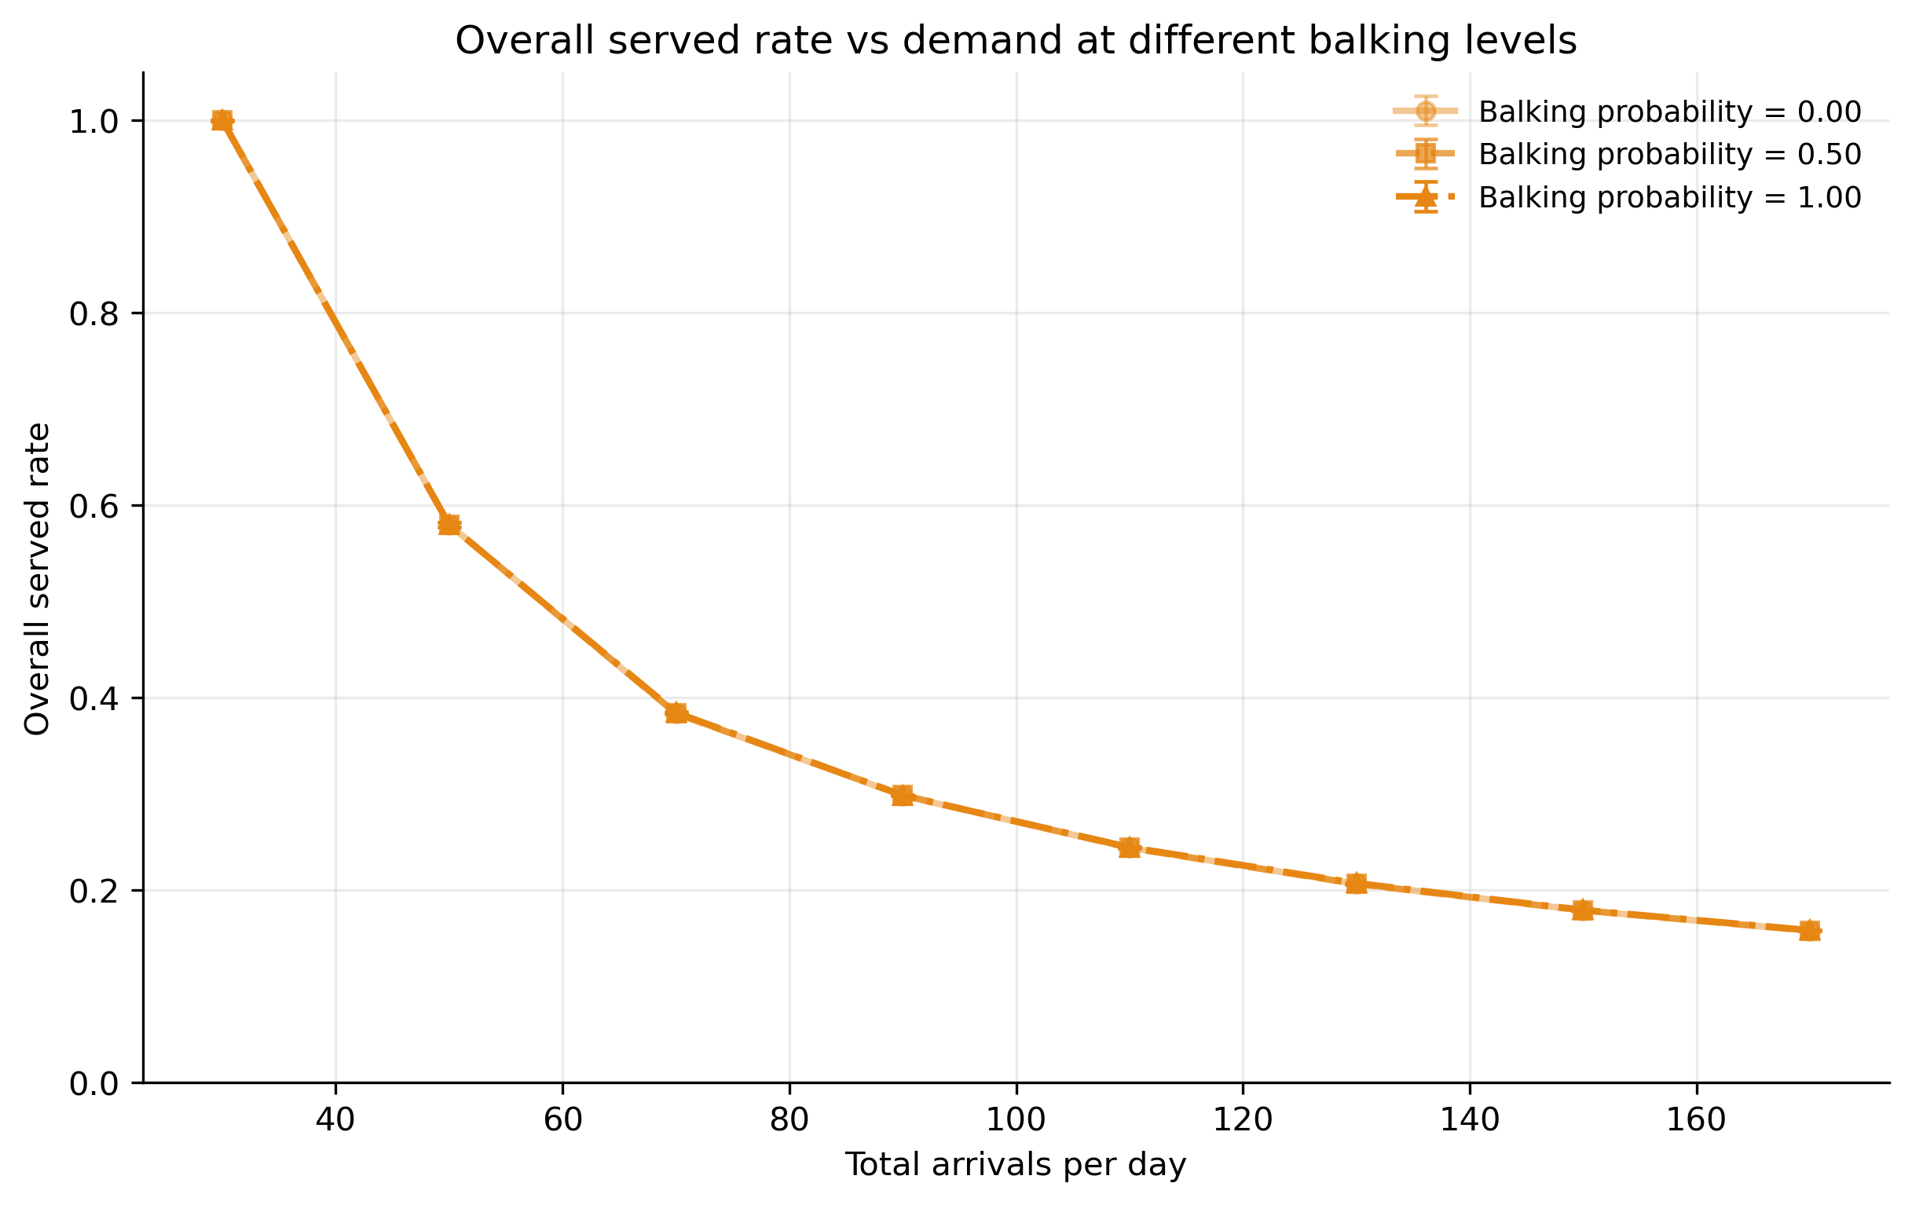
Demand is a big driver of served rate compounded by no-show
Under high demand, arrival becomes the main driver for served rate.
Balking rate has minimal effect while an increase in no-show post probability further drives down served rate.

Slide 7
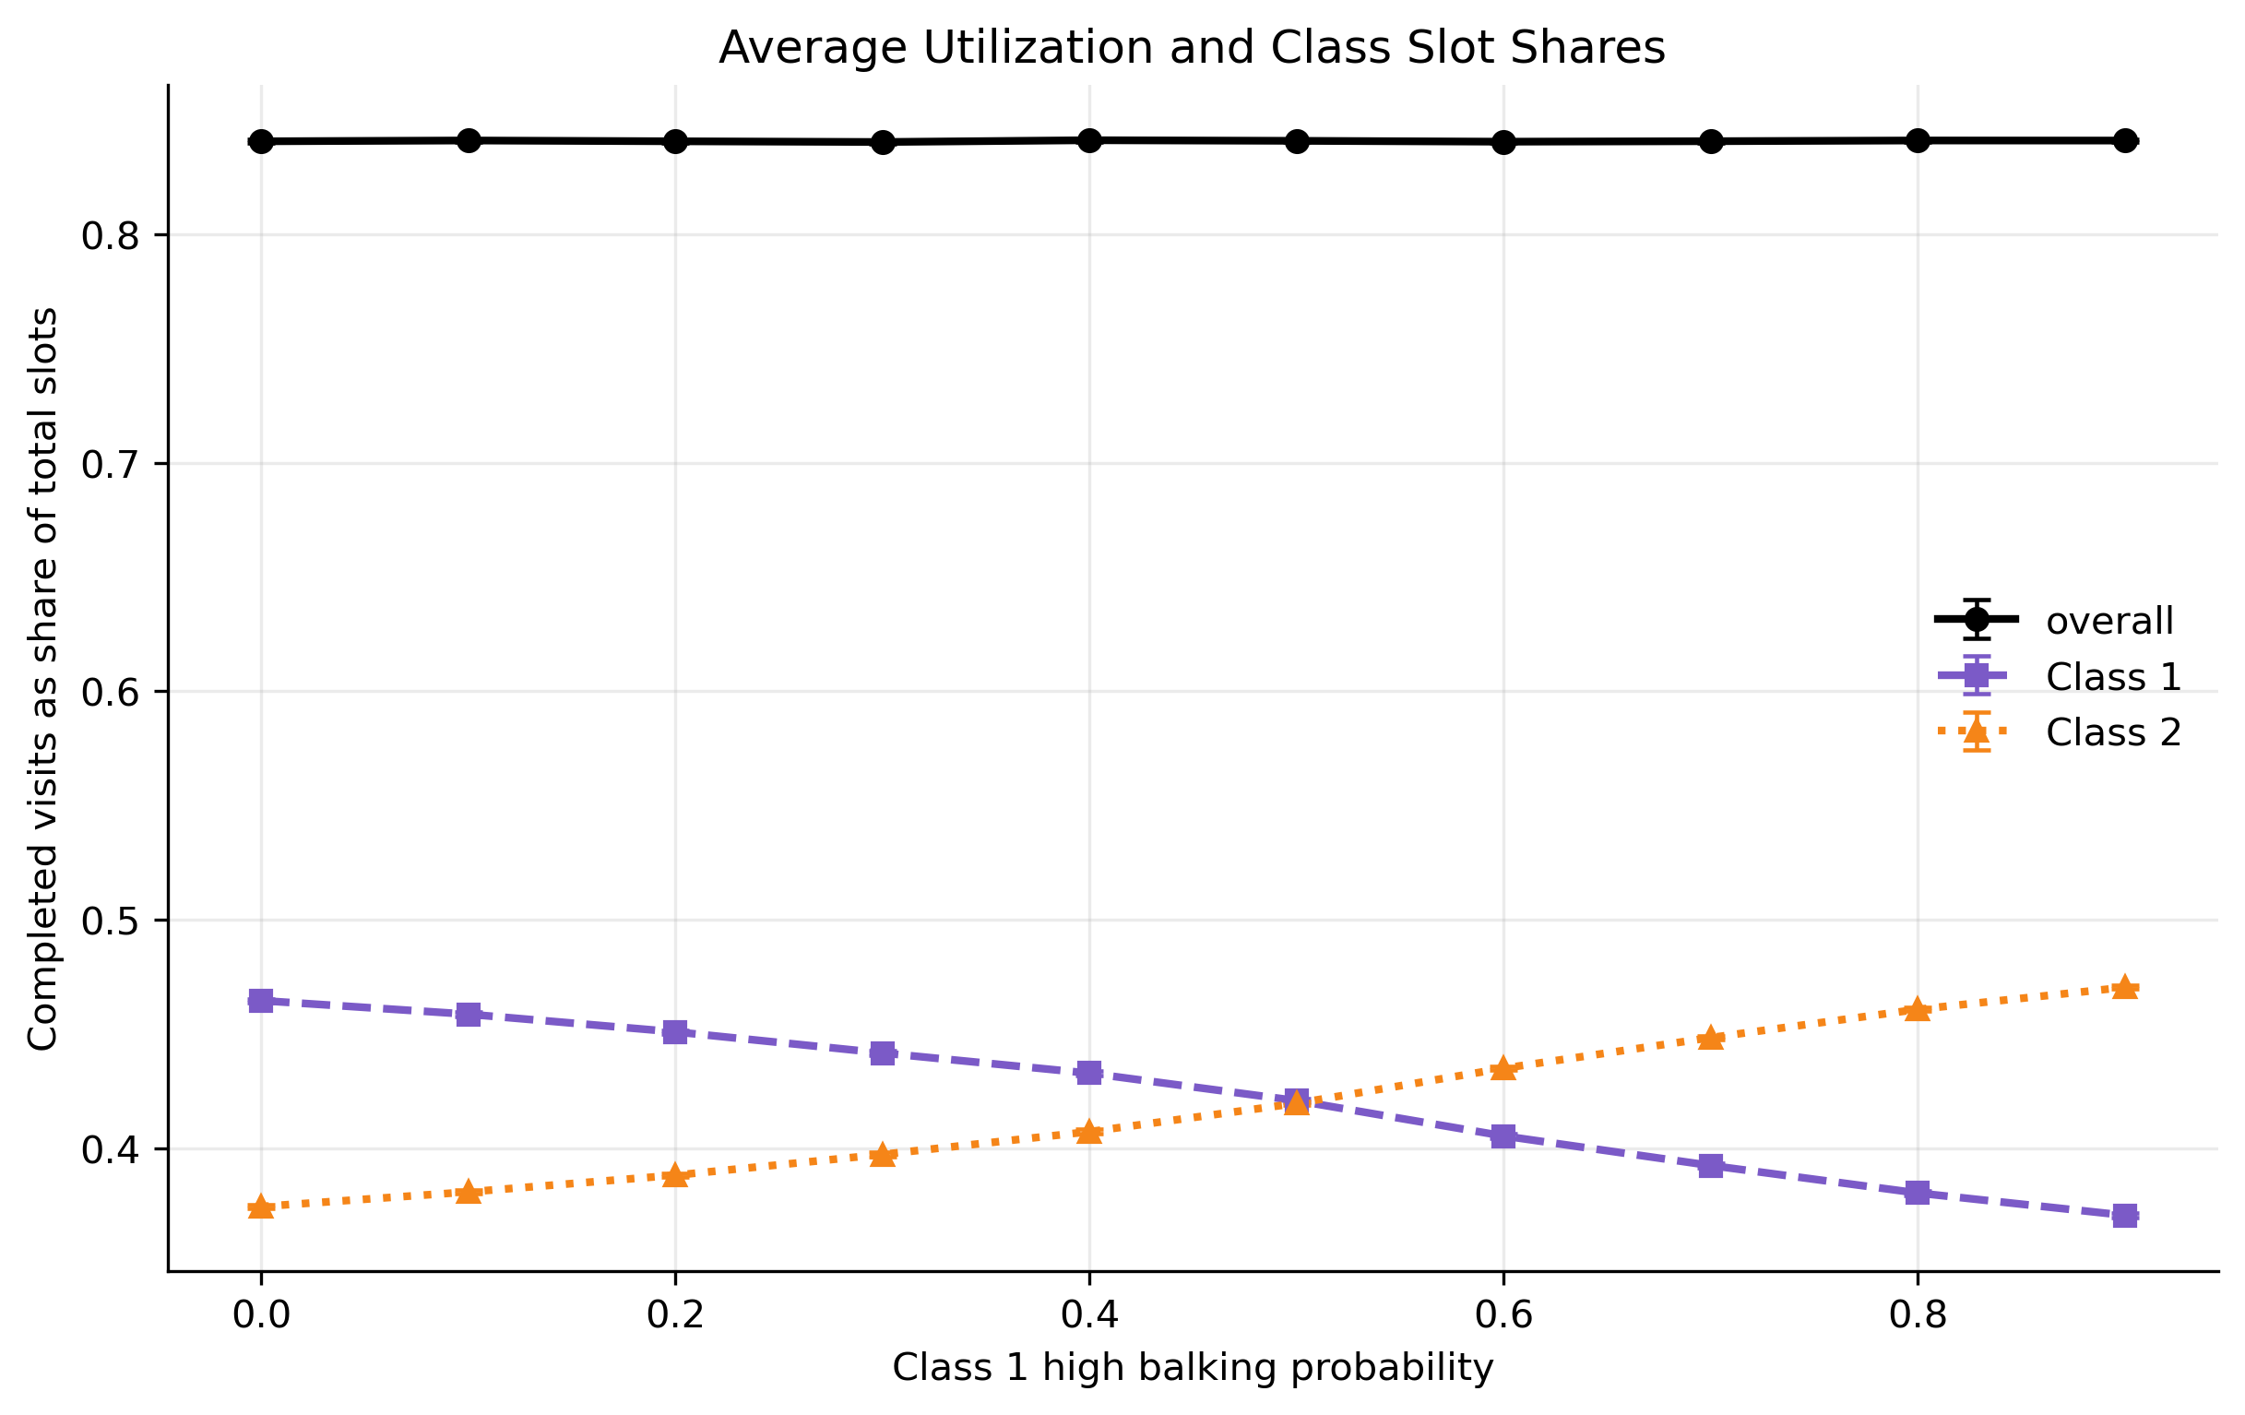
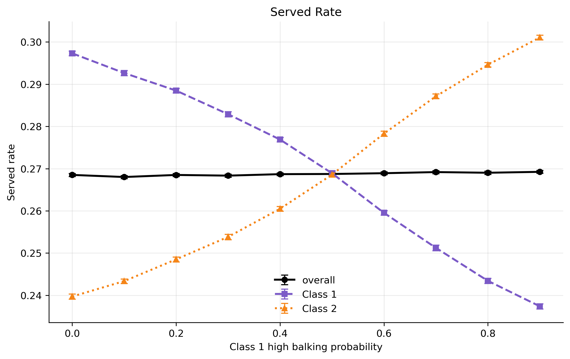
Under heavy demand, balking post probability shifts appointments to the more wait-tolerant group
Overall utilization and served rate is not impacted by balking post probability.
The wait-tolerant group takes over balked slots.

Slide 8
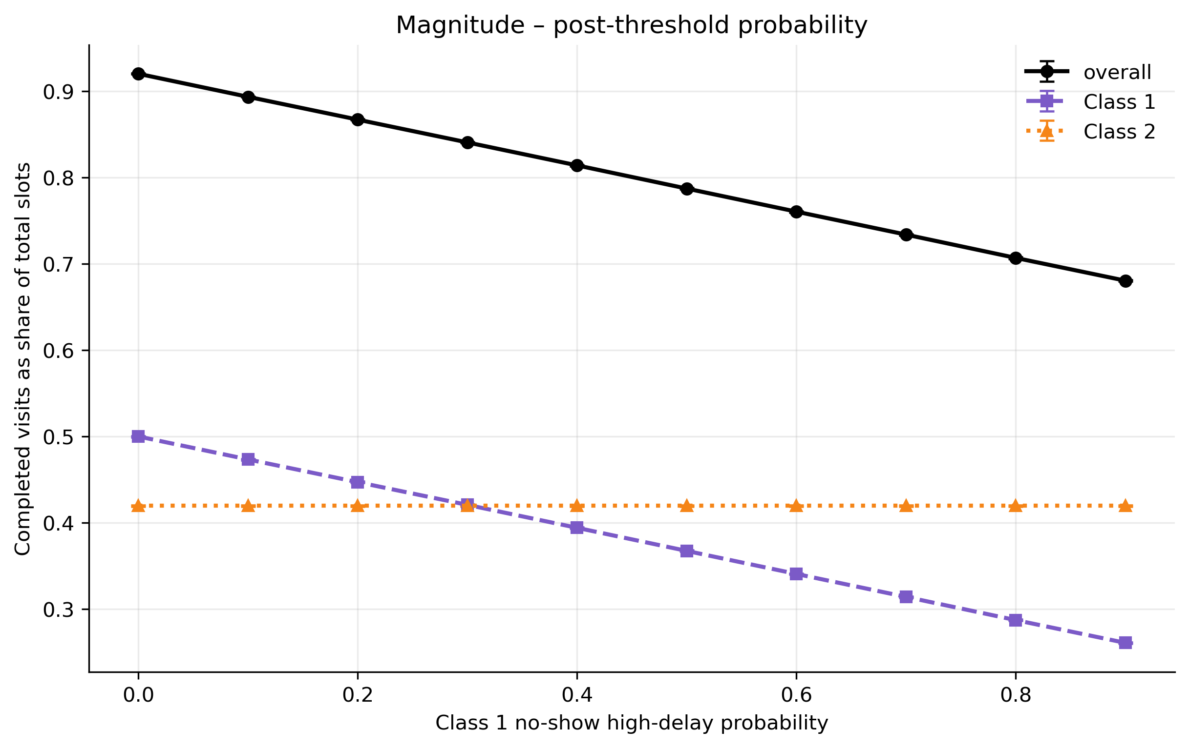
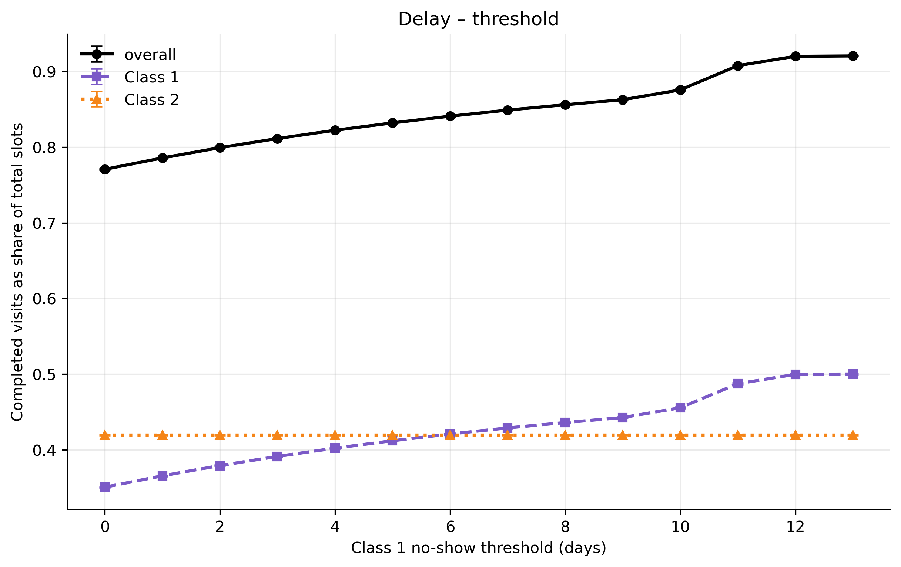
No-shows reduce average utilization and cause unrecoverable loss
In addition to the post probability of no-show and balking, the delay also matters.
For example, no-show threshold changes let more/less bookings fall before the no-show threshold.

Slide 9
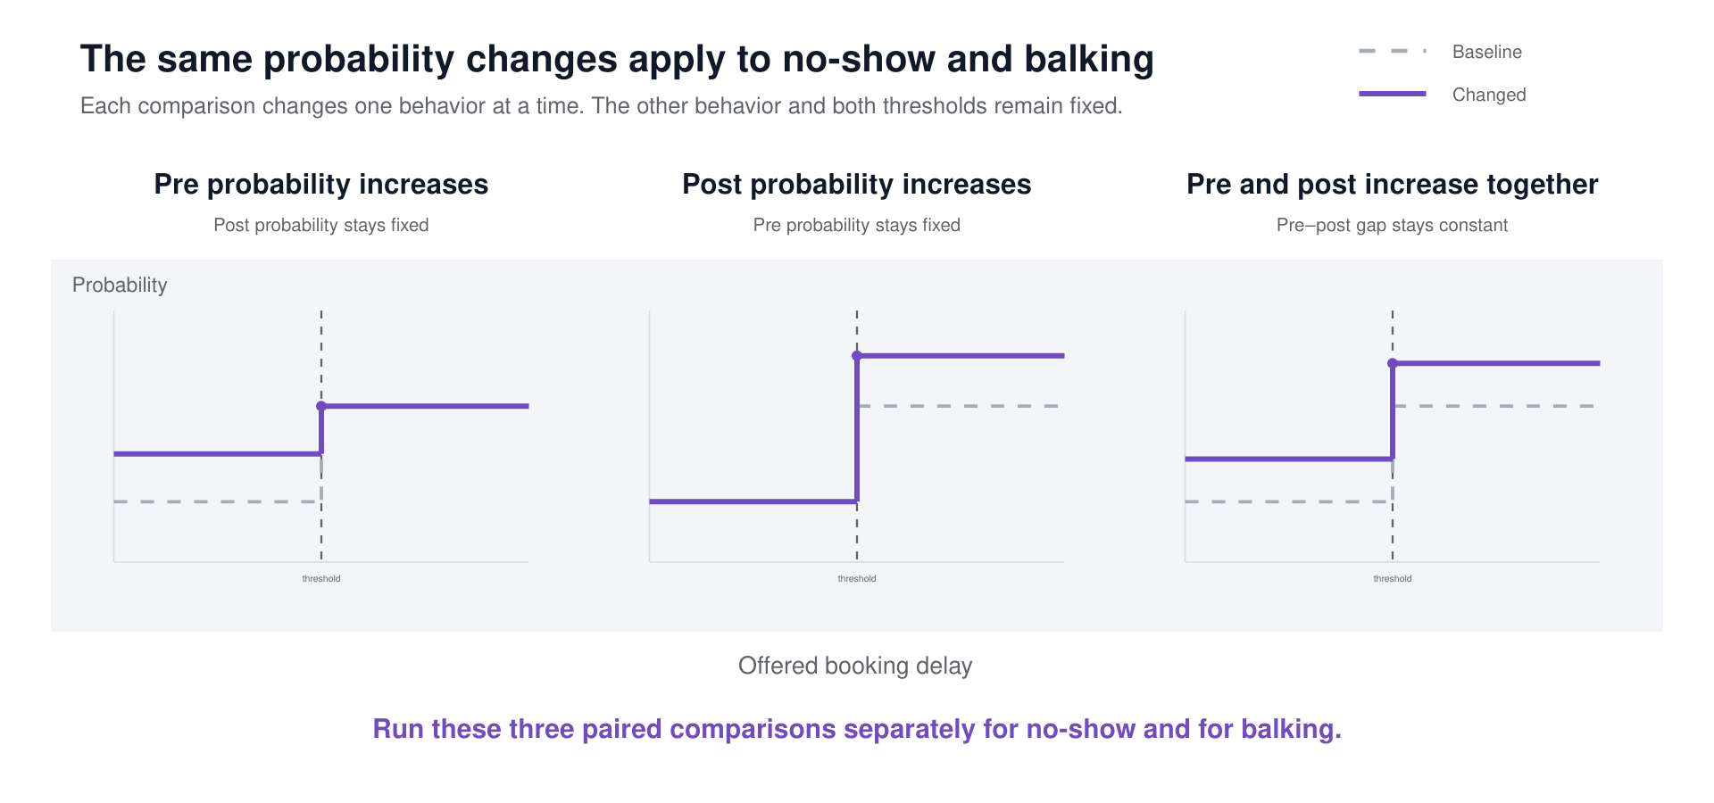
No-show vs. balking, how do they affect served rate?
Experiment design

Slide 10
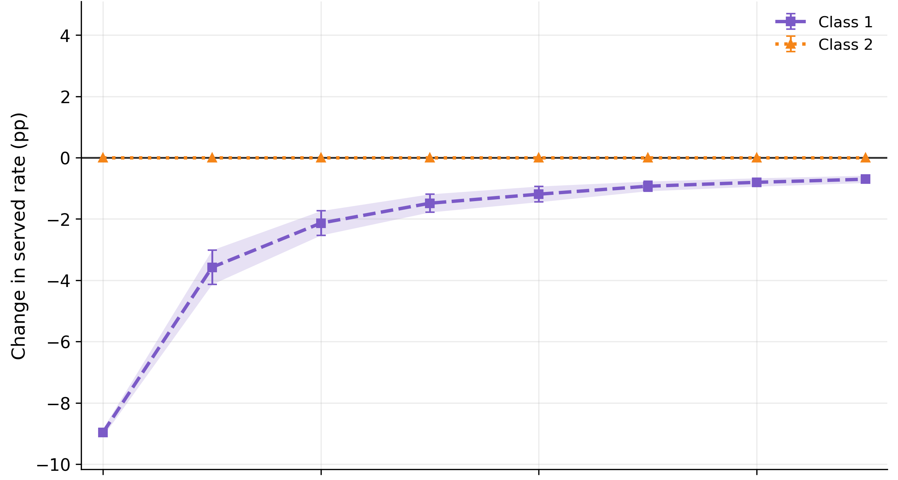
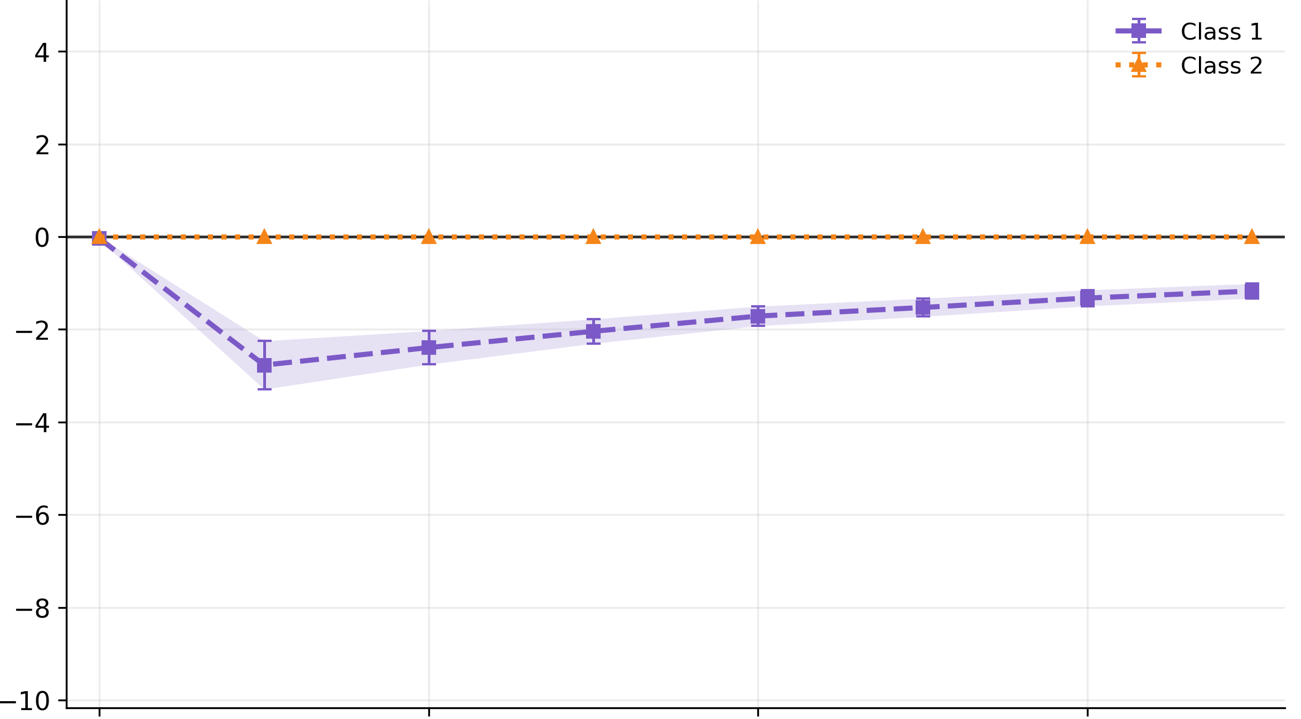
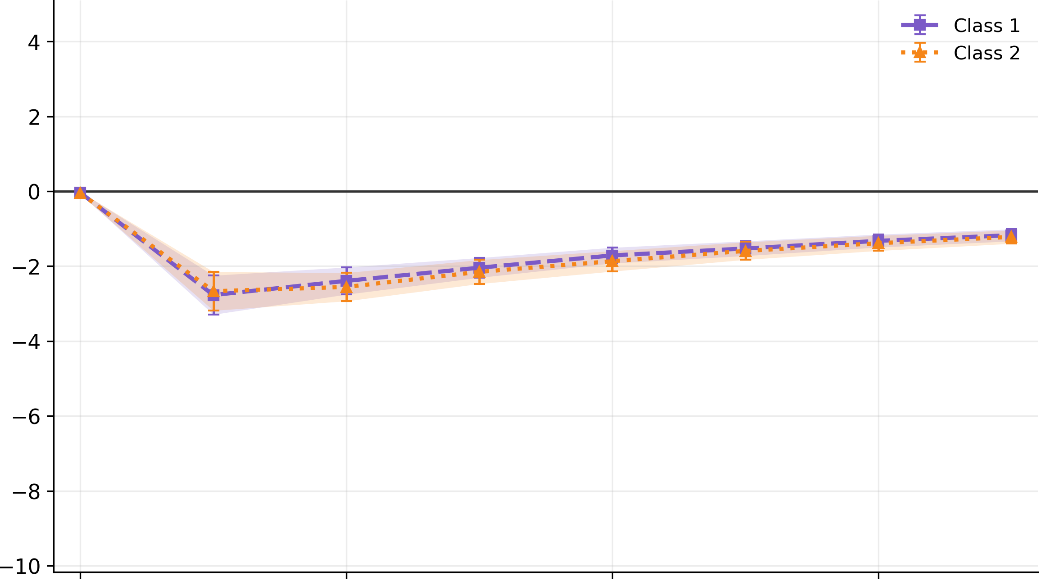
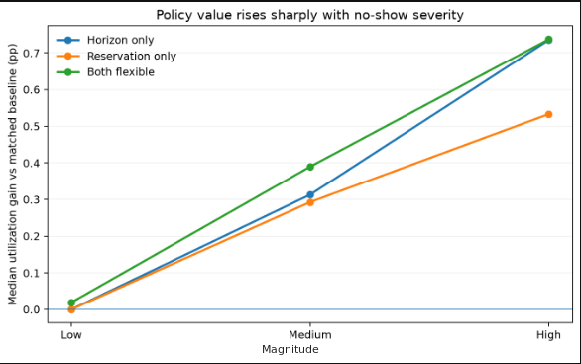
No-show heavily impacts the class’s own served rate
No-show’s served rate impacts come from the change in each class’s post probability. The other class’s served rate is not impacted.
No-show’s biggest served rate effects comes from pre-probability increases during low demand.
Demand

Slide 11
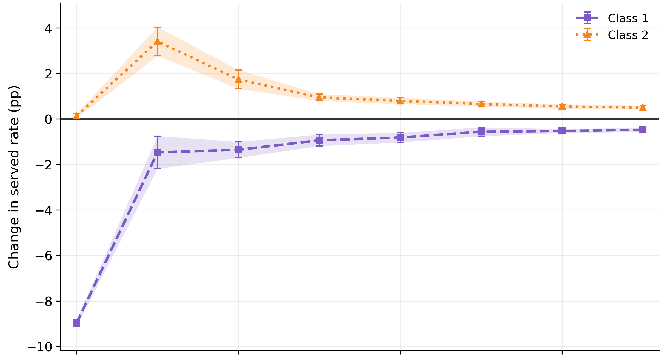
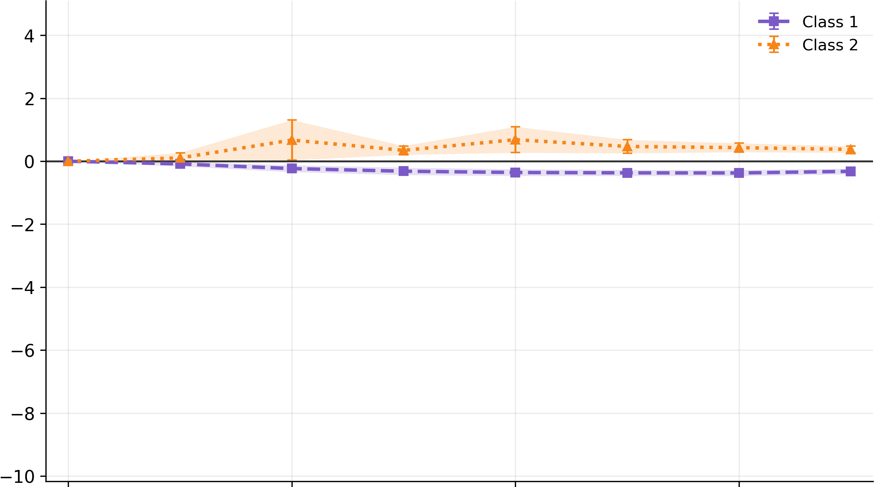
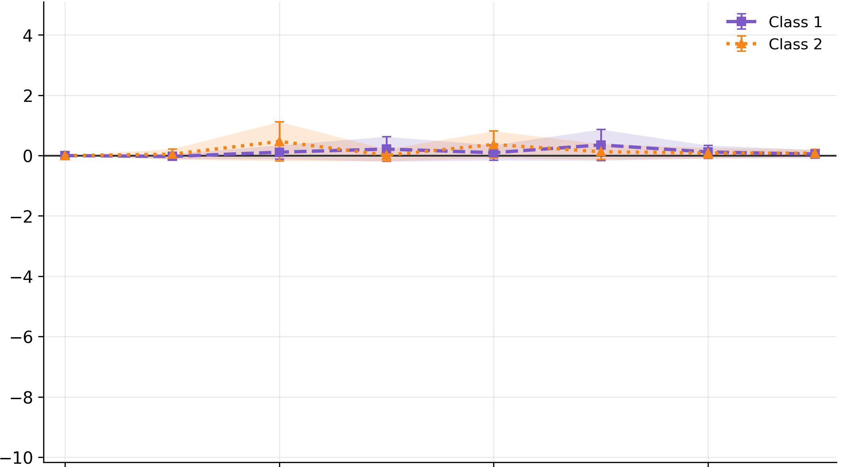
Balking impacts both classes’ served rate
Class 1 balking positively impacts Class 2’s served rate.
This impact peaks with pre-threshold balking at low to moderate demand.
Demand

Slide 12
Summary - no-show vs. balking on served rate
No-show
Balking
Served rate impacts come from the change in each class’s post-probability.
Minimally impacts the other class’s served rate.
Biggest impact is at low demand with pre probability
Consistent minimal changes from post probability balking on served rate.
Served rate effects positively impact the other class.
Biggest impact is at low demand with pre probability

Slide 13
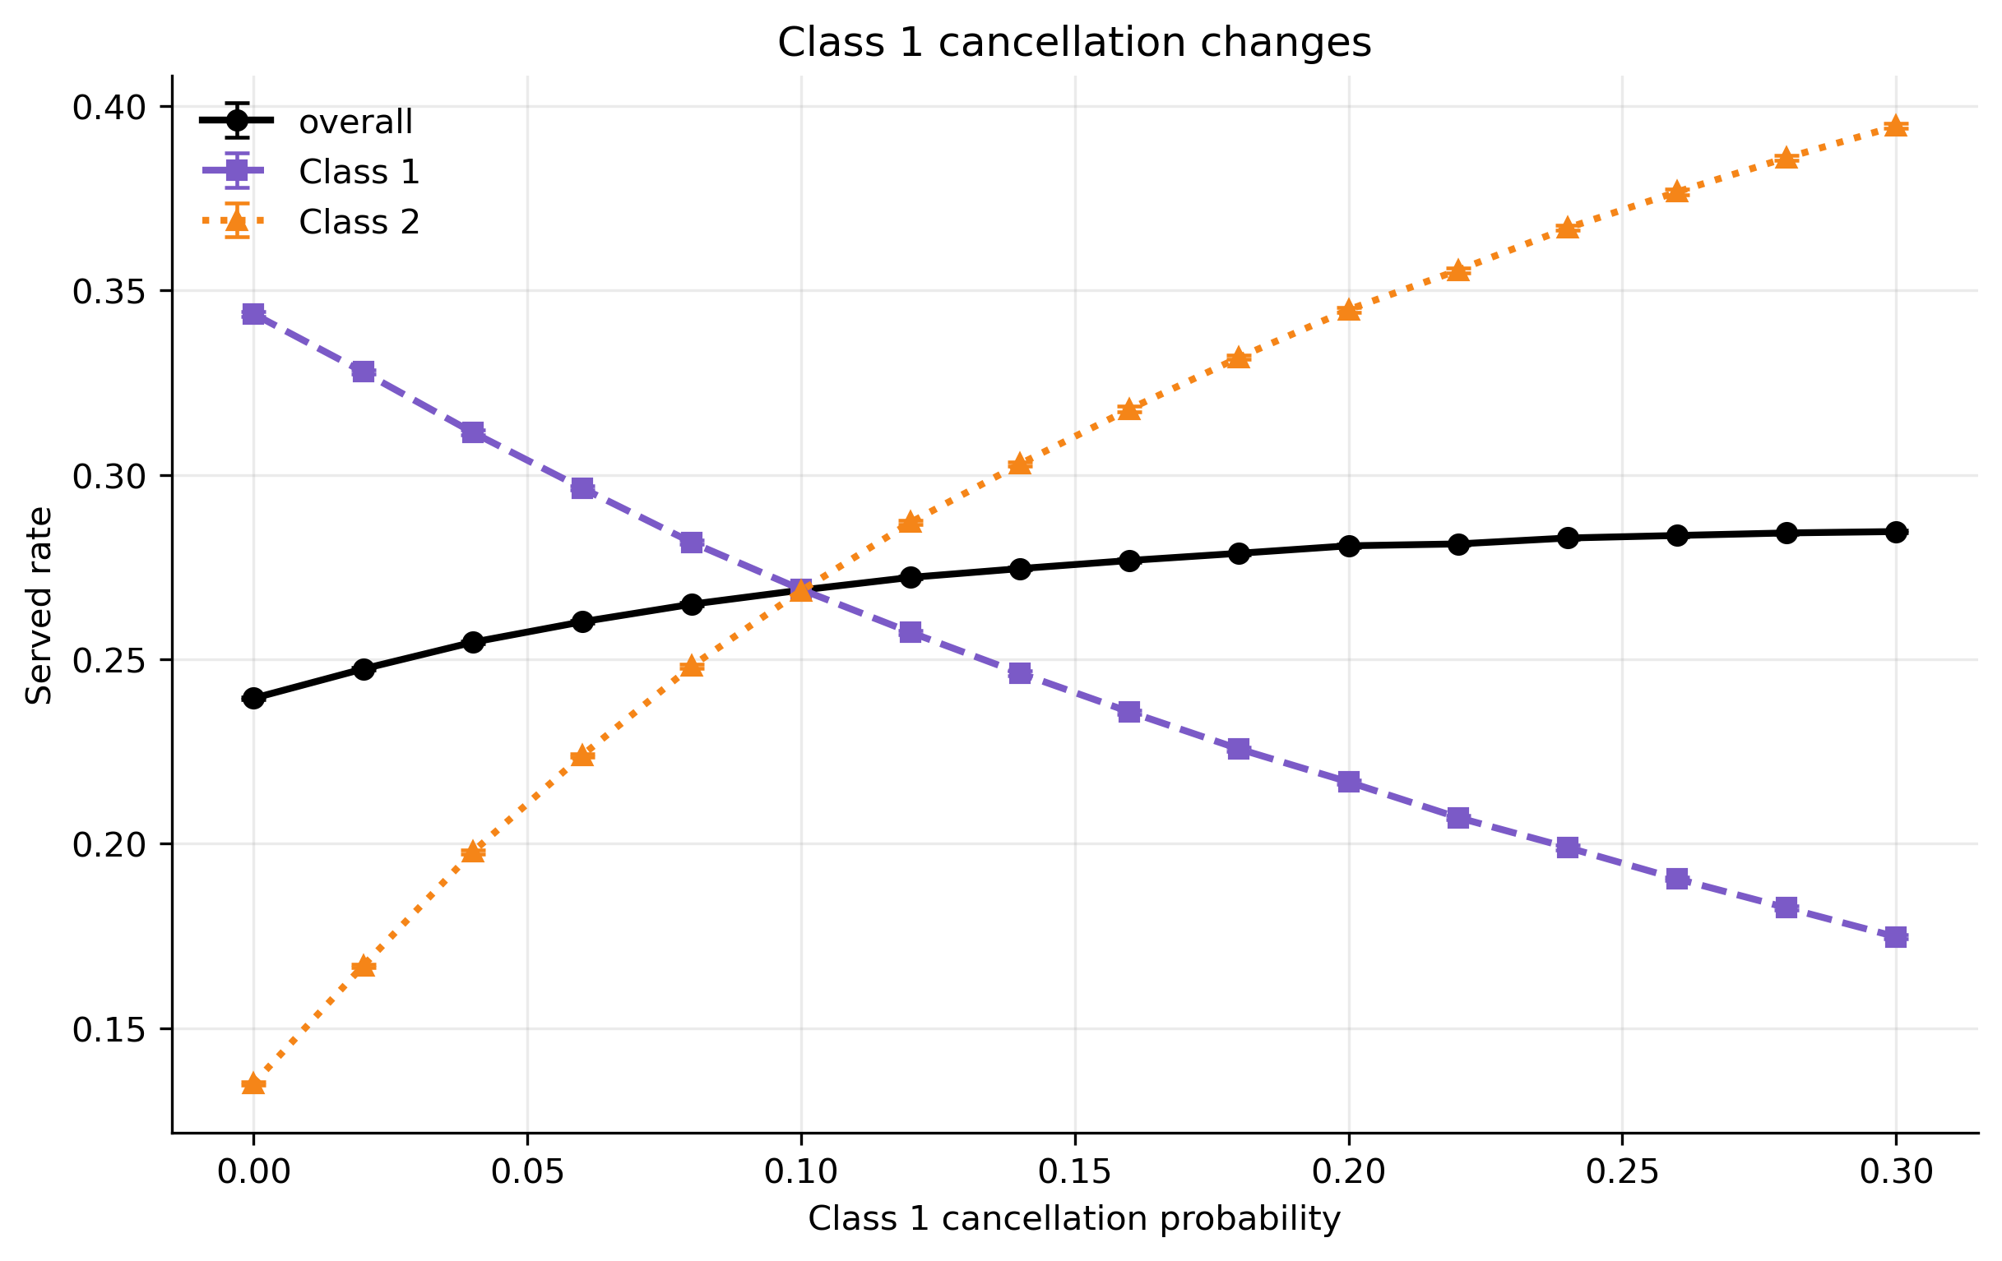
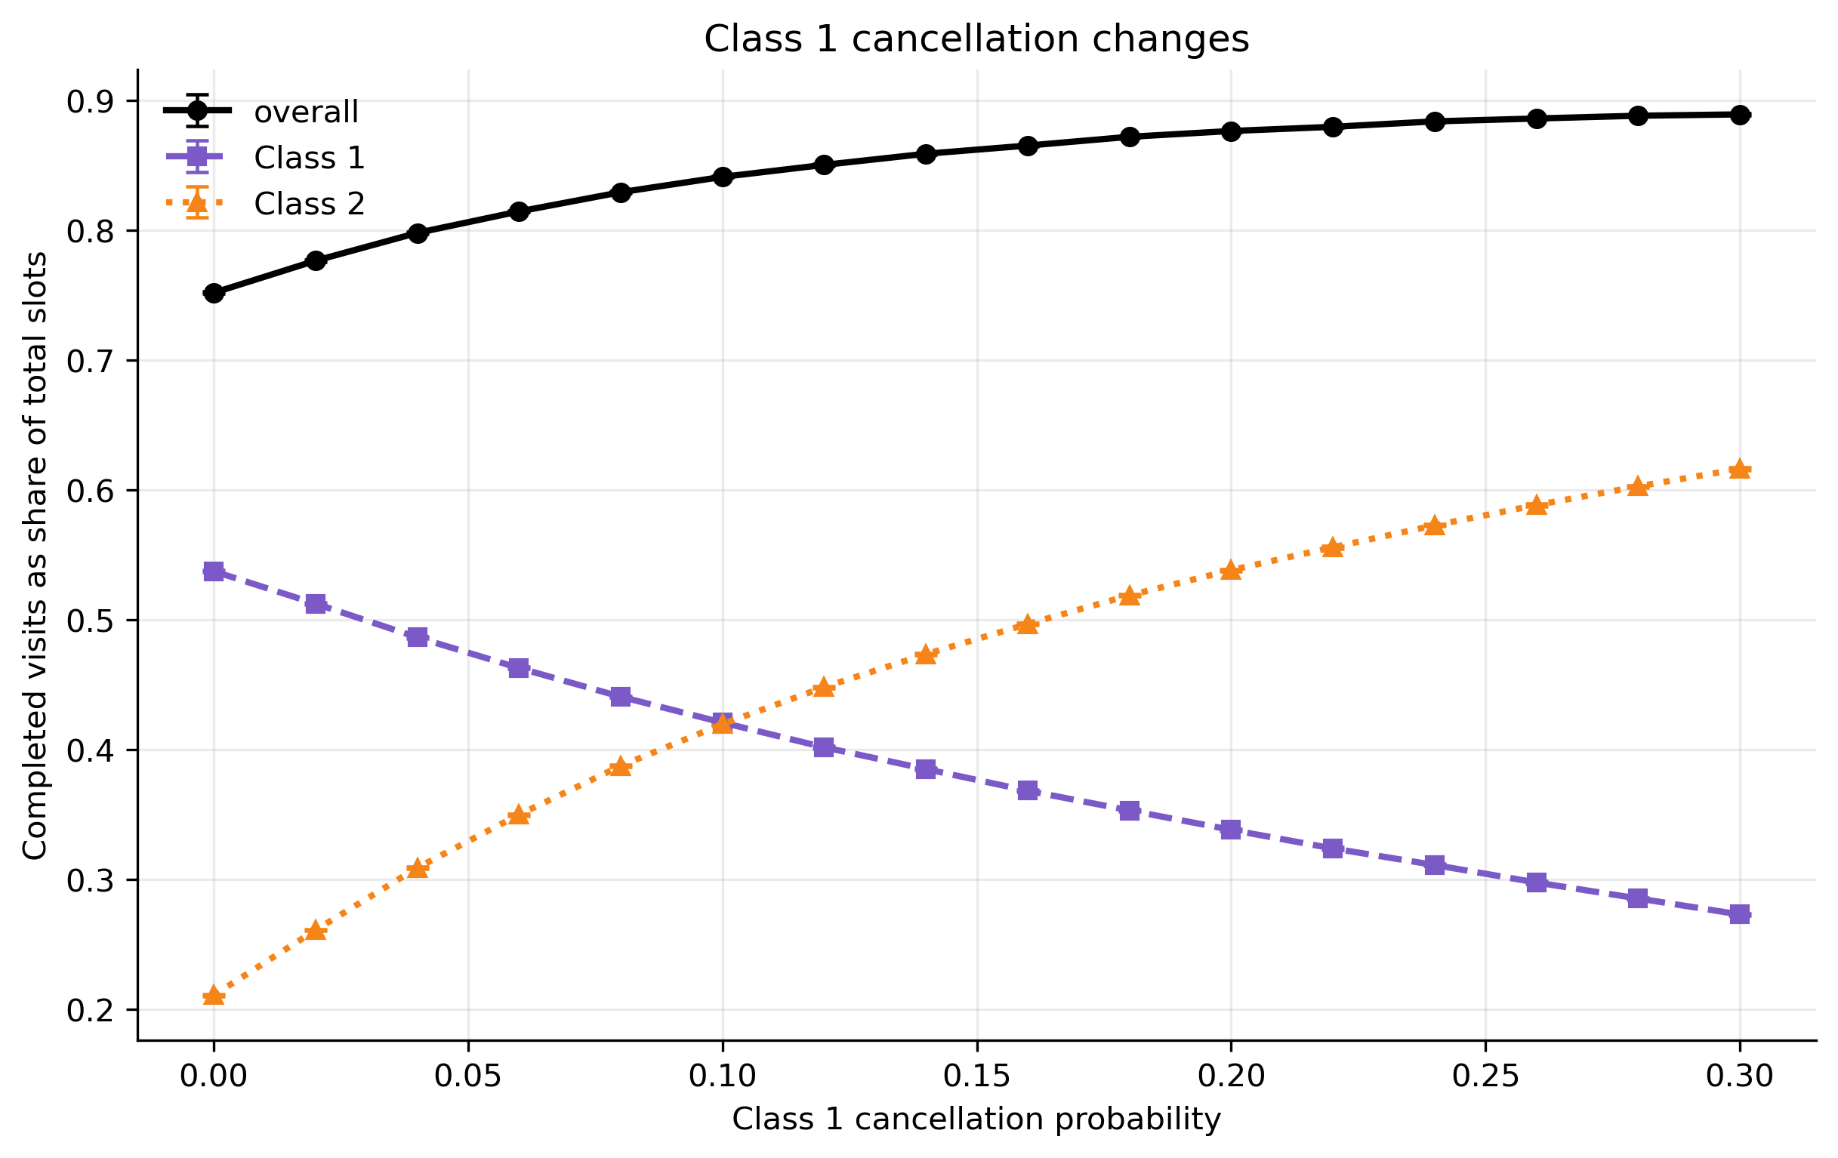
Cancellation redistributes access and does not waste capacity
Under high demand, cancellations transfer access from one class to the other without significant pooled changes.
Higher cancellation rate can improve utilization and waiting time by allowing appointments to be booked before behavior thresholds.

Slide 14
Summary
Demand is a big driver of served rate compounded by no-show.
Balking post probability mainly redistributes access away from the delay-sensitive group.
No-shows cause unrecoverable loss and waste capacity.
Delay sensitivity matters along with behaviour post probability.
Balking increase impact both classes' served rate while no-show only impact its own class’s served rate.
No-show post probability matters more than threshold gap for served rate.
Balking post probability has minimal effects on served rate.
Cancellation redistributes access and service between classes.

Slide 15
Next Step: can scheduling policy reduce harm?
Explore the impact of patient behavior on utilization, served rate, and waiting time when the booking horizon is flexible.
Discover how to optimize metrics by choosing reservation slots and reservation period.
What are the win-win situations of class access and efficiency when policies become flexible?

Slide 16
Policies in consideration
Booking horizon
  The horizon which bookings are restricted to
2. Reservation
  Allowing one class to have priority for certain appointments.
  This policy chooses both reserved slots per day and overall number of days that slots are reserved.
3. Combination of reservation and booking horizon

Slide 17
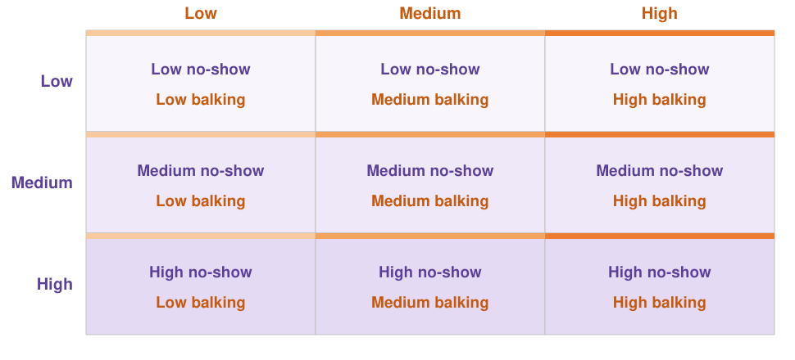
The 3x3 design
Balking post probability
No-show post probability

Slide 18
No-show post probability determines the effectiveness of policies on utilization
Higher no-show post probability increases the effectiveness of utilization gain from implementing booking horizon policies, reservation policies, and a combination of both.
Notes:
blurry

Slide 19
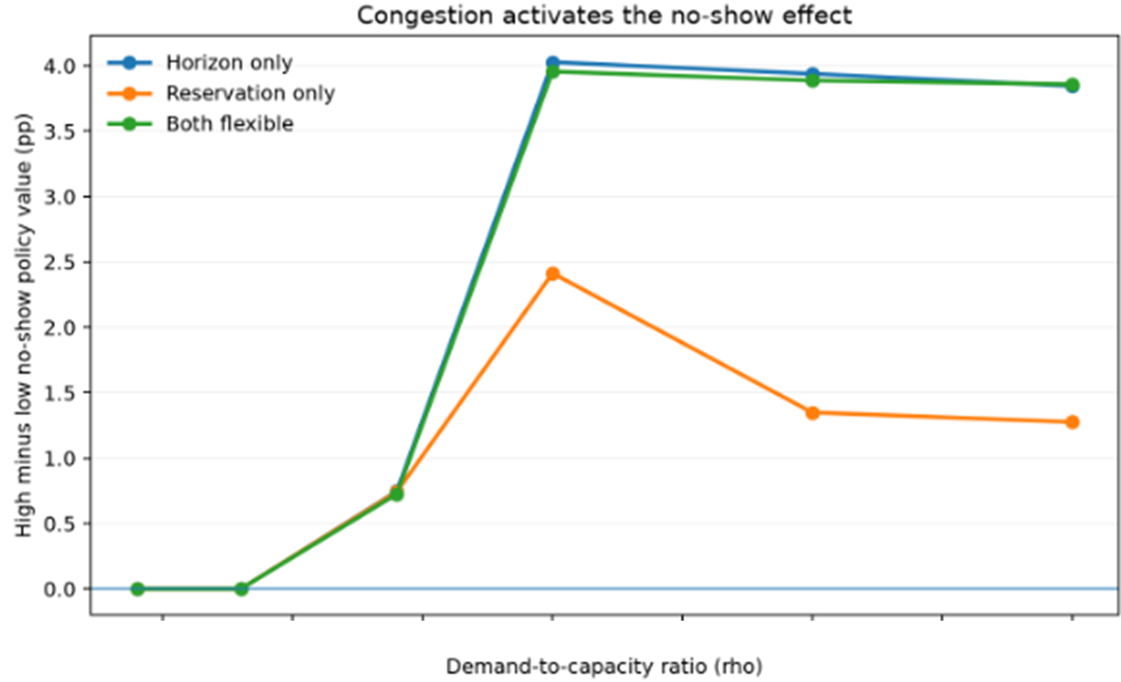
Demand activates the no-show effect on utilization
Demand is a necessary component to policies’ utilization effectiveness from no-show post probability.
Reservation is comparatively less effective because the horizon inflexibility pushes patients beyond the no-show delay at higher demand.
Notes:
Add that y-axis is median across balking, blurry

Slide 20
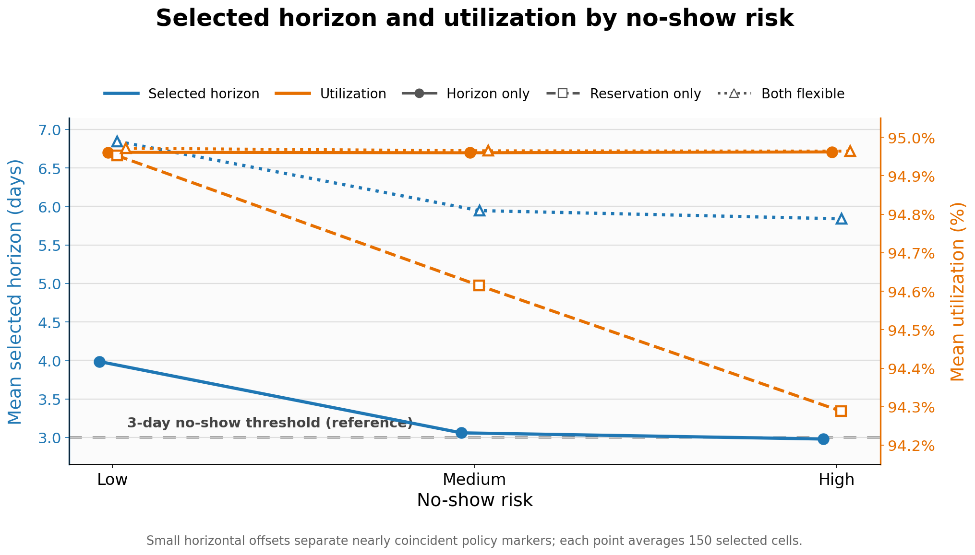
When optimizing utilization, horizon is usually cut short to prevent no-shows
Higher no-show post probability shortens optimized horizon.
Mean horizon selected is higher when reservation is added to the policy.
Horizon flexibility is more effective at regulating no-show risk than only reservation.

Slide 21
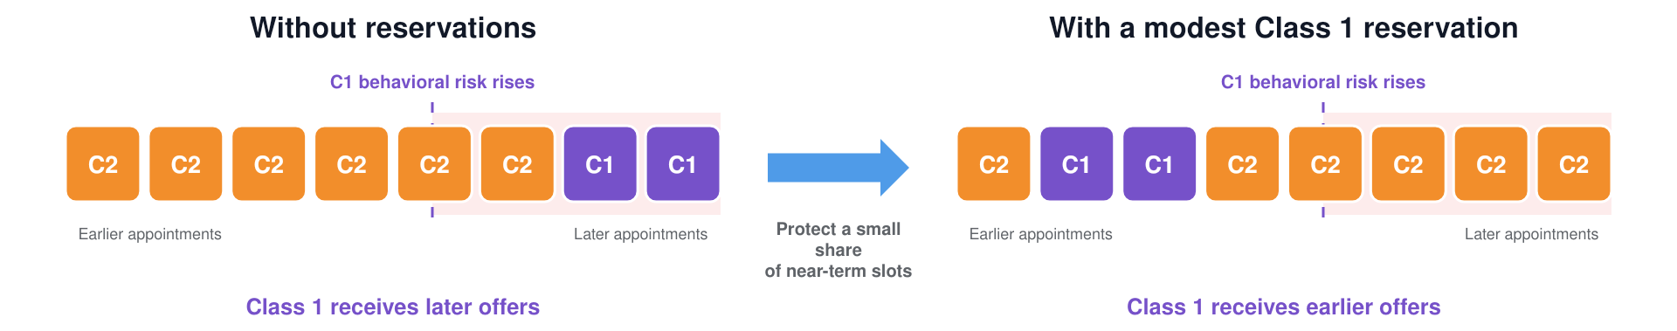
When can reservations improve Class 1 access without hurting Class 2?
We are looking for improvements from reservations policies on served rate while maintaining within -0.5% of optimized utilization.
A representative example:
Let Class 1 be the reservation class and the most delay-sensitive class

Slide 22
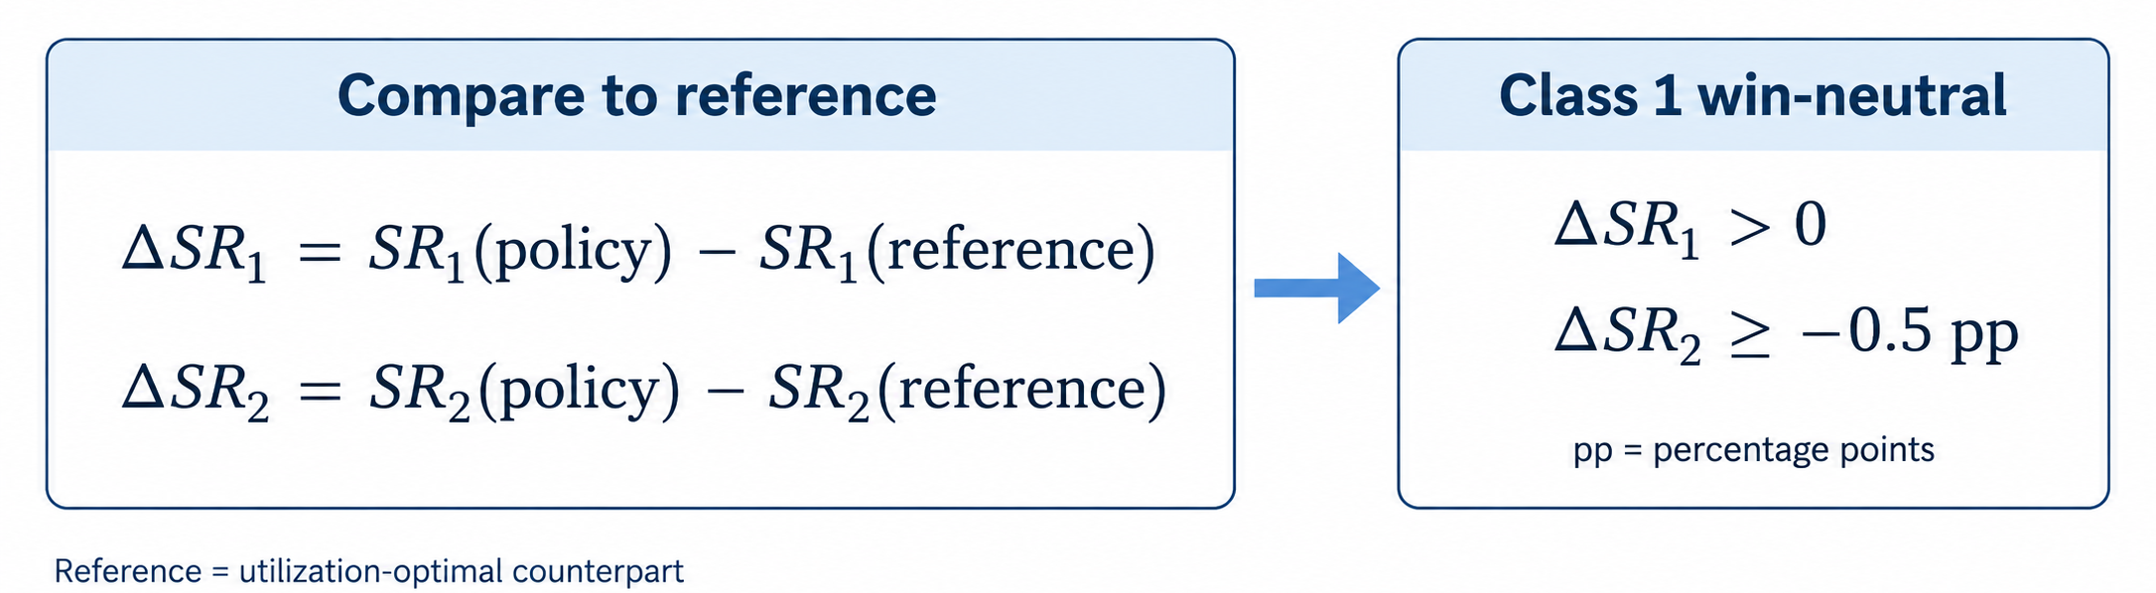
When can reservations improve Class 1 access without hurting Class 2?
No validated cases of meaningful improvements to both classes.
However, while utilization is maximized, we can improve Class 1’s served rate while not meaningfully impacting Class 2.

Slide 23
Reservation-only
The policy with the largest C1 gain among favourable cases.
Win-neutral happen when:
  Class 1 is a small portion of the queueing population.
  There is moderate to heavy demand.
  Cases are more common with higher no-show severity.
Both-flexible
Win-neutral happen when:
  Class 1 is a small portion of the queueing population.
  There is heavy demand.
  No clear behavioral severity trend.
Class 2 is more delay-tolerant in this design to allow the win/neutral cases the to happen.

Slide 24
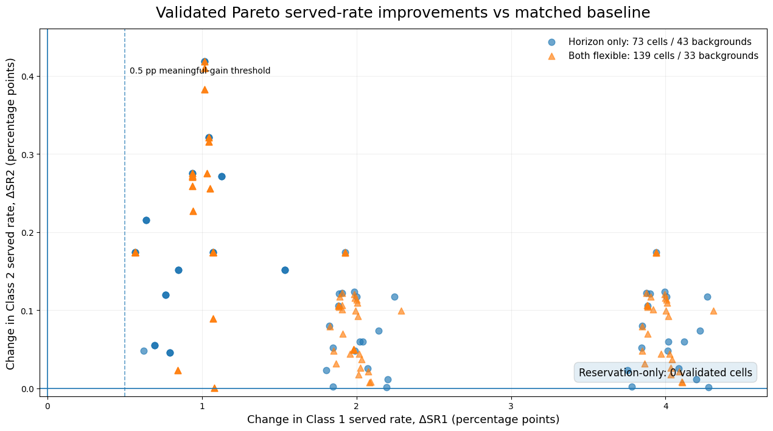
Looking pass utilization, where are class access Pareto improvements in served rate?
When ignoring utilization, what patterns can we draw from pareto policy improvements?
There are no validated reservation-only scenarios
Notes:
Horizon
Reservation slots per day and length
- What are the policies chosen, how reasonable are they

Slide 25
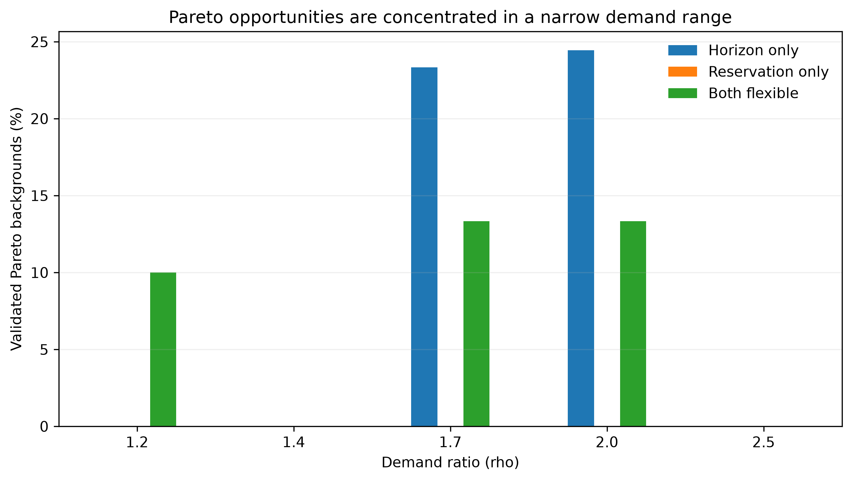
Demand and Pareto opportunities
There are more pareto opportunities for specific demand ratios.

Slide 26
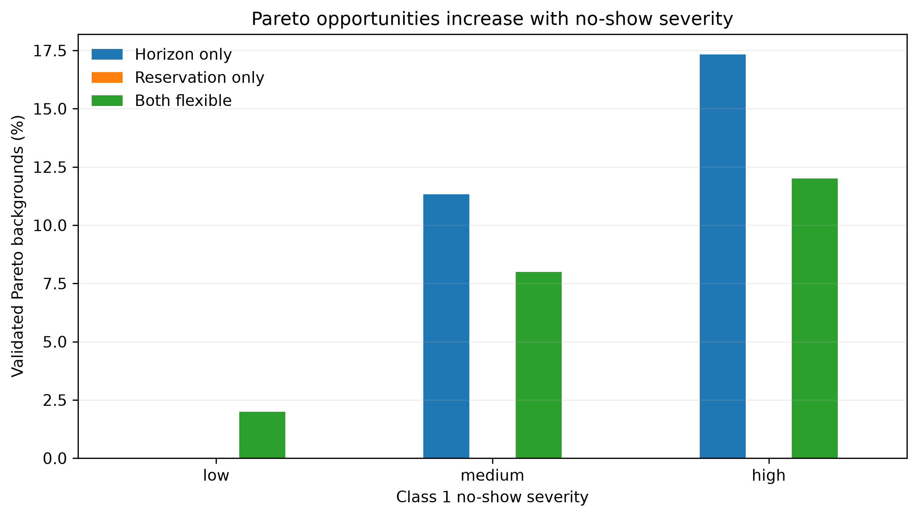
No-show matters more than balking in Pareto
There is a clear trend that higher no-shows lead to more Pareto opportunities.

Slide 27
Higher daily capacity helps protect class 2?
At high Class 1 patient share, Pareto happens more at lower daily capacities
At low Class 1 patient share, Pareto happens more at higher daily capacities

Slide 28
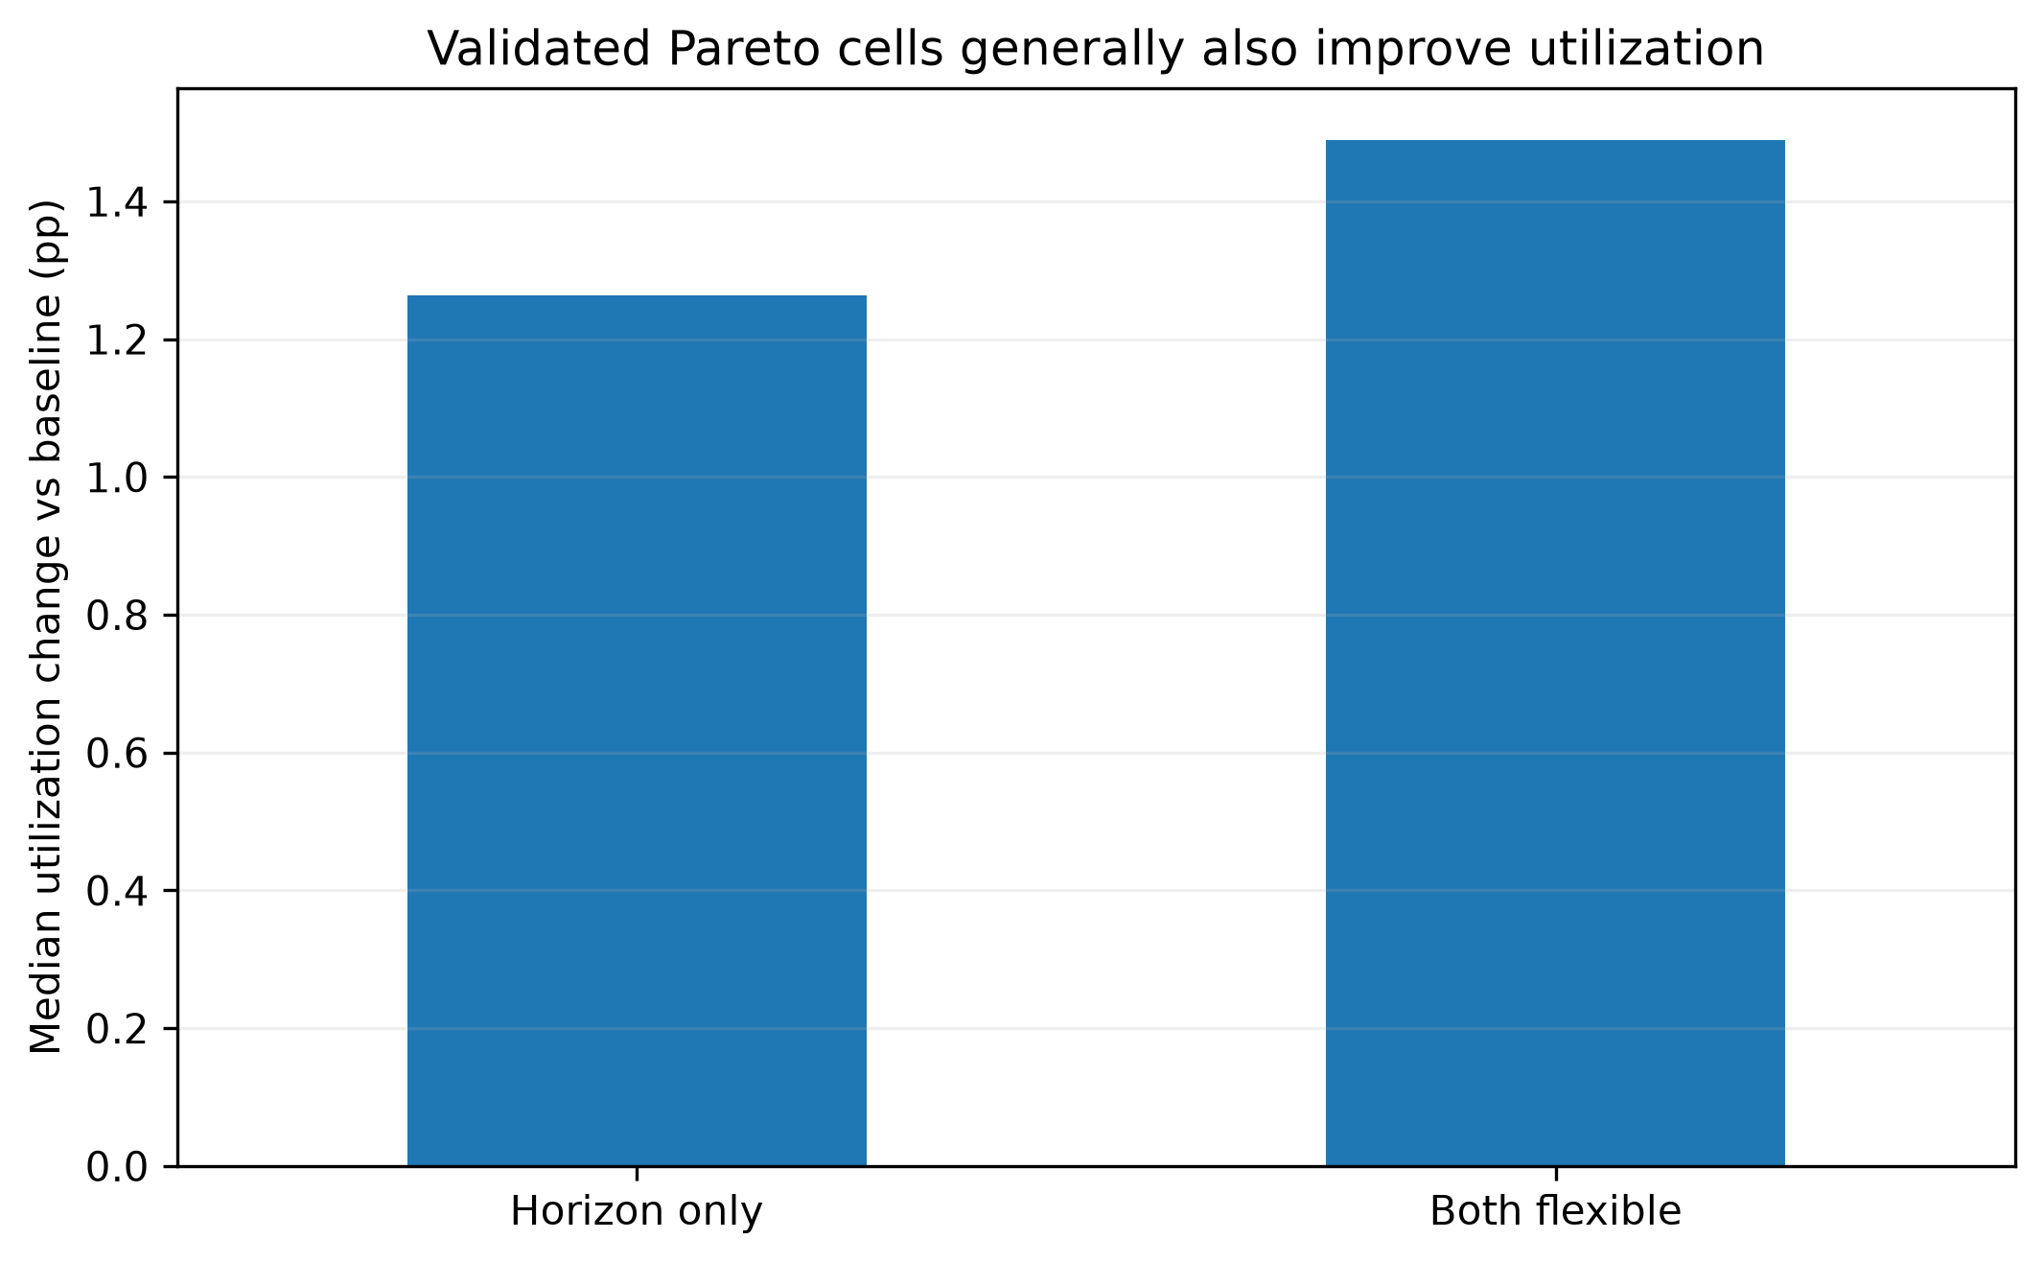
In the served rate pareto improvements, utilization is still higher than no policy
Both flexible policy has a higher median positive change than horizon only in the Pareto improvement scenarios.

